Slide 1
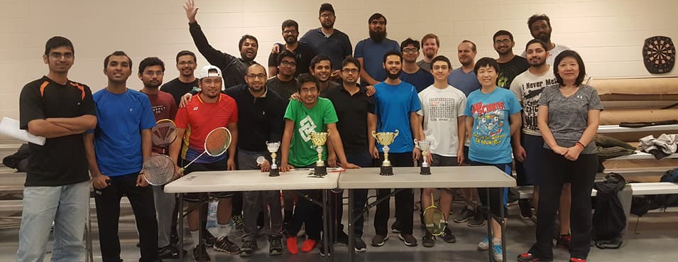
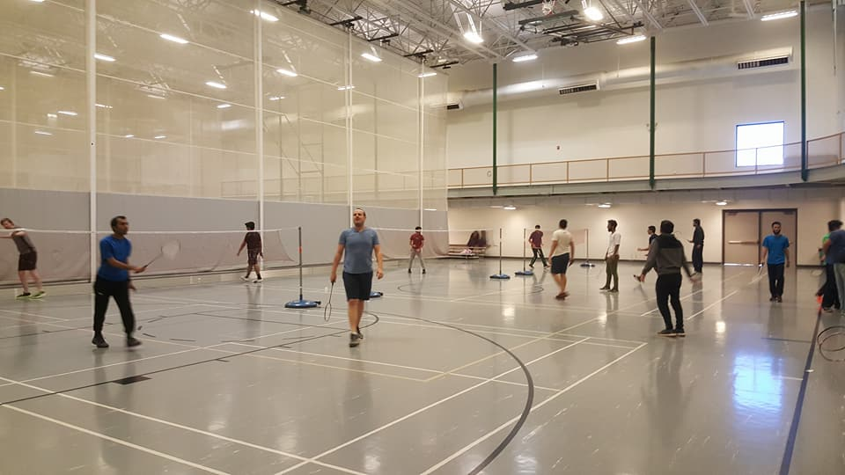
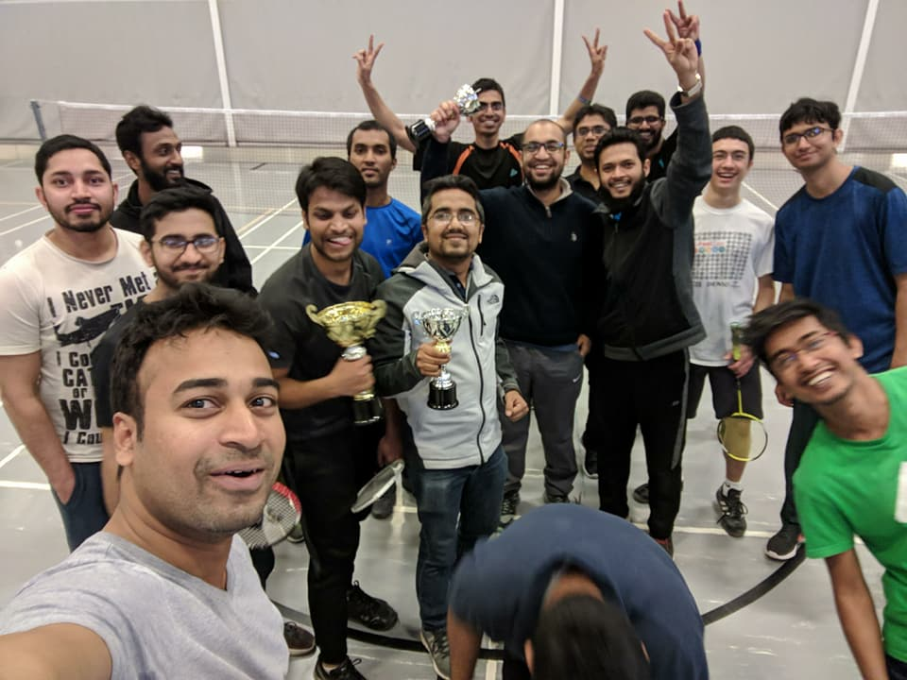
Done
Badminton Tournament!!

Slide 2
On going
Summer Research Fellowship- Announced!
Travel Grants- Announced!
Initiatives
Visiting hi-tech facilities- campus Nuclear Reactor !!
Next
Graduate Research Showcase

Slide 3
Boot Camp
Registration: No Fee!! Certificate Included.
Google form: https://goo.gl/forms/IOuqd5tyeYFfbjUl1
Expectation
Inter-disciplinary Course
Research and Professional Development
Google Docs: Course content (proposed) for review and edit
https://docs.google.com/document/d/1UOcQvjLRS_kXs0pMU4Wr6CNjPFY7tkFnXIa3__xrrvc/edit?usp=sharing

